Slide 1
The role of EPs to support Collaboration and Coproduction in Relationships, Sex and Health education (RSHE) for learners identified with Special Educational Needs and Disabilities (SEND)
Dr Natalie Carpenter
Notes:
This training is the result of work that started in 2015 when I was a psychology assistant supporting a piece of EP work on puberty training. It was then I became aware of the dearth of resources and knowledge in this area. I continued this with my first year doctoral pilot study (unpublished) looking at systemic support for SPL schools for SRE (as it was known then). I continued this work into my doctoral thesis which took over 5 years to complete which used PAR to understand how a support group for staff could support the nuances of implementing an RSHE curriculum in a Specialist provision. This work provided a model for using a setting up and using a support group to facilitate RSHE using the views of key stakeholders and supporting staff. This training is the result of this work, it has been recently updated in the light of the Westminster Forum debate on RSHE 8/11/23, updates from the government 2024.
Contract- our contract today-
Consent, confidentiality, safety, non judgment (jargon busting chicken, chains of the past)

Slide 2
Plan for session
Quiz
Reflection
Sharing work and information
Case studies and EP role
Dr Natalie Carpenter
Notes:
This training is the result of work that started in 2015 when I was a psychology assistant supporting a piece of EP work on puberty training. It was then I became aware of the dearth of resources and knowledge in this area. I continued this with my first year doctoral pilot study (unpublished) looking at systemic support for SPL schools for SRE (as it was known then). I continued this work into my doctoral thesis which took over 5 years to complete which used PAR to understand how a support group for staff could support the nuances of implementing an RSHE curriculum in a Specialist provision. This work provided a model for using a setting up and using a support group to facilitate RSHE using the views of key stakeholders and supporting staff. This training is the result of this work, it has been recently updated in the light of the Westminster Forum debate on RSHE 8/11/23, updates from the government 2024.
Contract- our contract today-
Consent, confidentiality, safety, non judgment (jargon busting chicken, chains of the past)

Slide 3
Aims
To consider the opportunities and vulnerabilities for CYP identified with SEND in relation to RSHE.
To consider the EP role in supporting collaborative RSHE with the voices of all stakeholders.
To consider the EP role in supporting collaborative and coproduced development of policy and practice and managing change in schools.
To consider the EP role in promoting early intervention.
To consider how EPs can create reflective spaces to support key stakeholders to grapple with challenges and cultural nuances of RSHE.
To consider how EPs can incorporate supporting RSHE in their everyday role and promote existing opportunities.
Notes:
Format of the day-lots of discussion and planning
Contract
slido

Slide 4
The Story So Far
2015
Puberty workshop
2016–2017
Systemic support research project
2017
2017 onwards Lived Experience
2019–2021
Thesis- PAR
2023
Published Article –EP in P
2024
Collaboration with Public Health
2024
Blogs
2024
AEP conference
Notes:
Olden thread- research, socio/political changes, reflection on EP work.

Slide 5
Quiz
Setting the scene- context and history

Slide 6
1)When did RSHE first appear in schools?
a The late 19th century
b After WW1
c After WW2
d 1950s

Slide 7
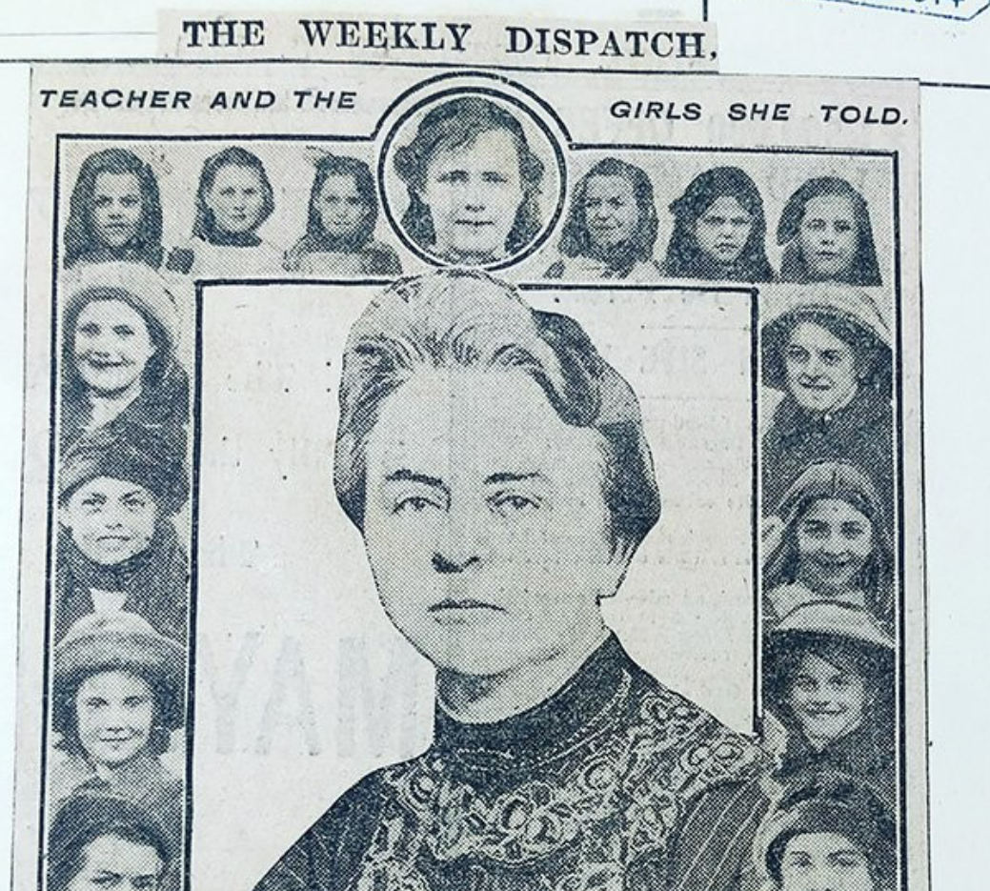

Slide 8
2)When did gender inequality and feminism start to impact RSHE education?
a 1960s
b 1980s
c 1990s
d 2000s

Slide 9
1)What year did RSHE become statutory in the UK?
a 1988
b 1996
d 2020
c 2000

Slide 10
1)In 1986 there was moral panic-why?
a AIDS
b sexual identity
c materials used in schools
d loss of innocence of children

Slide 11
“Yesterday, when I was kneeling in the snowdrops, in the woods at home, picking fresh white blossoms with their sharp, sweet scent, they made me think of the innocence, purity and loveliness of children”.

Slide 12
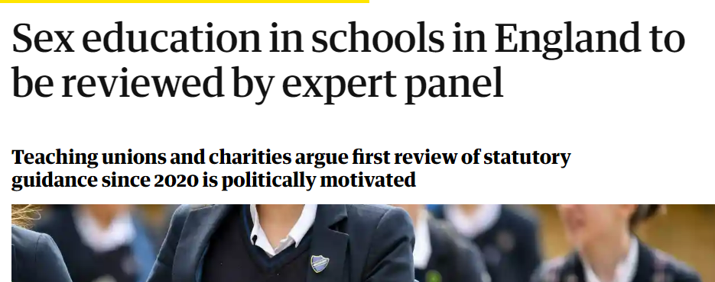
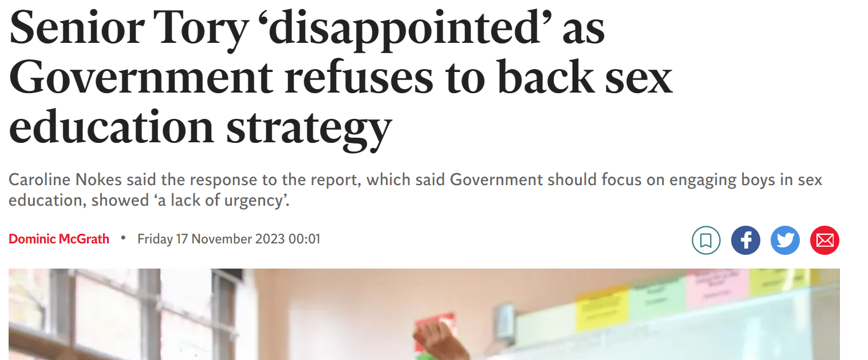
RSHE in the News
Notes:
Katie 2 mins
RSHE has always been a polarising topic, coloured and flavoured by individual and sociatal morals and views. It is often highly politised with extreme views being highlighted in the press and debates being hijacked by thin/sensationalised accounts which are often used to shock. Since RSHE became statutory there has been a variety of practice, which is currently being questioned and reviewed with many wishing to take account religious and political belief systems as well as considering who should be imparting this information and at what time (educational vs personal/private).

Slide 13
What is RSHE?
Relationships, Sex and Health Education (RSHE) is learning about the emotional, social and physical aspects of growing up, relationships, sex, sexuality and sexual health.
RSE includes:
Physical aspects of growing up, including how our bodies change.
Emotions and how to recognize them and manage them.
Social influence (including positive and negative social influence from peers-Sex Education Forum)
Notes:
RSHE encompases the social, emotional and physical aspects of growing up and developing friendships, relationshisp and sexual partners. It is closely linked with our ever changing society and individual views and beliefs. It is a highly nuances subject which requires opportunities for questions, reflections and an upto date understanding of our changing world.

Slide 14
A Moment to think
What are your memories of learning about RSHE?
Where did you find out about different parts of RSHE?
What underpins your views about RSHE?
What underpins your views about RSHE for learners identified with SEND?
Notes:
First we must reflect ourselves:
Take a moment to consider these three questions.
What has changed In society since you learnt about RSHE, is it lifelong learning?
What might be your personal biases?
As a heterosexual, middleclass female I am aware I do not have the lived experience of many other groups and seek to hear and understand their voices and viewpoints. My political leanings are liberal and I hold education and inclusion close to my heart. I was brought up in a blended family who were emotionally open and liberal in their view points about sexuality and marriage but not about gender identity.

Slide 15
WHO teaches RSHE?
Hidden Curriculum RSHE Draft.mp4

Slide 16
Why teach RSHE?
Children and young people who receive high quality RSHE are more likely to:
Have consensual relationships
Delay the age of first sex
Prevent unwanted pregnancies and look after reproductive health
Be aware of and report abuse.
Notes:
RSHE aims to equip pupils with information, skills, values that they needs to have safe, for fulfilling and enjoyable relationships and take responsibility for their sexual and reproductive health. It also protects them from exploitation and abuse.
Can you think of any more benefits of RSHE?
What makes a good life?
The support for RSHE is overwhelming! CYP will learn about RSHE from many sources (friends/media-hidden curriculum). Preferred sources are parents, schools and health professionals.
RSHE provides opportunities for safeguarding, understanding and having positive/healthy relationships and making informed decisions about life.

Slide 17
Rationale
Learners with SEND have been historically disregarded, infantilised, villainised or overprotected in relation to RSHE.
Narrow teaching materials struggle to address nuanced socio-cultural factors, attitudes and beliefs.
Research calls for collaborative and participatory approach with involvement of all stakeholders.

Slide 18
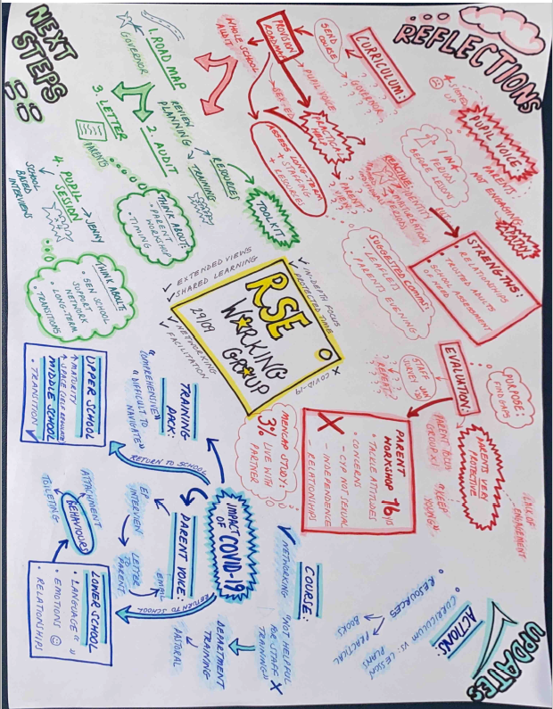
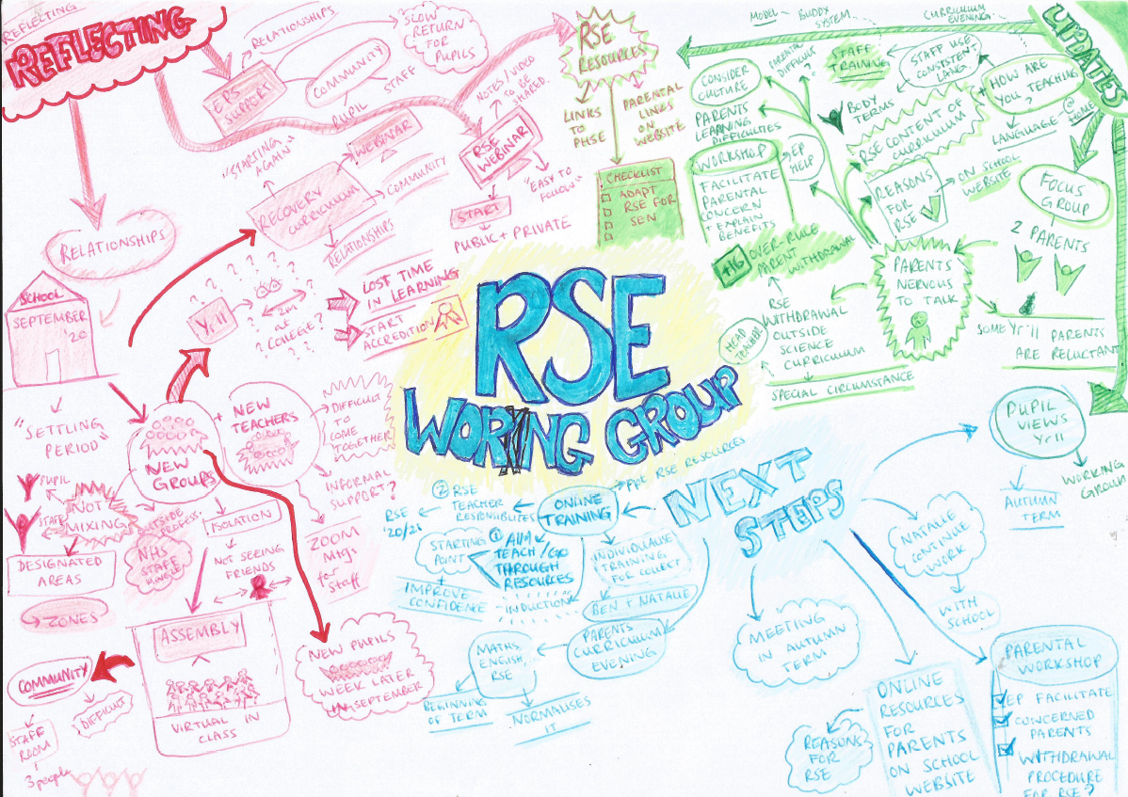
Developing a Relationships and Sex Education (RSE) Support Group for Staff in a Special School using Planning Alternative Tomorrows with Hope (PATH): a role for Educational Psychologists
Carpenter et al. (2023)

Slide 19
Perceptions of the role of the EP
Conceptualisation of the EP role
Value of EP as a group member
EP as faciilitator
EPs and change

Slide 20
Support group perceptions of the EP role in RSHE group
EP as group member
EP role in change
New conceptualisations of EP role
EPs as facilitators
Notes:
RSE has undergone recent legislative changes - all schools being required to deliver RSE as a statutory requirement from September 2020. In May 2024 conservative government guidance was reviewed and is currently out for consultation.
RSE has historically lacked guidance for all learners but there is further ‘reluctance and confusion’ regarding the delivery of RSE to pupil’s with SEND
Learners with SEND have been historically disregarded, infantilised, villainised or overprotected, when is comes to RSE.
Parents and staff seem to be restrained by narrow materials which struggle to address nuanced, dichotomised socio-cultural factors, attitudes and beliefs.
Research calls professionals to work collaboratively to allow the participation of all stakeholders, however there is little guidance informing frameworks which support this way of working.

Slide 21
Staying SEEN
S say
E embedded in culture
E early intervention
N normalise and nurture challenging conversations

Slide 22
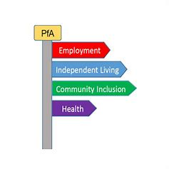
RSHE and Areas of SEND/PfA
Communication and Interaction
Cognition and Learning
SEMH (Social, Emotional and Mental Health
Sensory and Physical
Self-help and Independance
Notes:
RSE has historically lacked guidance for all learners (Stewart et al., 2015), however there is further ‘reluctance and confusion’ regarding the delivery of RSE to pupils with SEND (McDaniels & Fleming, 2016).
RSHE sits comfortably within each area of the SEND code of practice, as well as in the strands of the preparing for adulthood framework.
Please take a moment to map RSHE onto these areas, where is it applicable?

Slide 23
Using the Scale of Emotional Development-short
SED-S (Sappok et al. 2016) In ‘The Psychologist’ November 2024
Designed for adults identified with SEND.
For caregivers to attune specifically to the person’s needs
An alternative to other models which focus on challenging behaviour rather than the environment.
Covers different areas of emotional functioning ( i.e. affect regulation, differentiating emotions and relating to others)
Looks to see which stage the person’s needs are at in order to meet these needs.

Slide 24
Functions of an EP
Assessment
Consultation
Research
Training
Intervention
Notes:
Mckay (2009)- consultation, assessment, research, training and intervention

Slide 25
ELSA
Emotion Coaching
PATH
DP4
Relationship policy
ABAS 3
Notes:
Mckay (2009)- consultation, assessment, research, training and intervention

Slide 26
Case study 1
Hugh is an 8-year-old boy who has just started Year 4. He was adopted from care when he was 8 months old. He has differences in his social communication and abilities to recognise and regulate his emotions. He was given a fixed term exclusion in Year 3 for inappropriate touching of another pupil. School have invited an EP for a home/school consultation.
What is the role of an EP during the consultation process and going forward in relation to RSHE?
What tools, approaches or resources might you turn to?
How can we support collaboration and coproduction?

Slide 27
Case study 2
Leon is 15. He lives at home with his parents and his older sister. At 2 he had a stroke and was left with an acquired brain injury; he later received a diagnosis of autism. He has been educated at home since he was secondary school age. His family are practicing Jehovah's Witnesses. Leon’s parents have asked him to stop masturbating and have told him it is wrong to do so. His parents have applied for an EHCNA.
What is the role of an EP during the assessment process and going forward in relation to RSHE?
What tools, approaches or resources might you turn to?
How can we support collaboration and coproduction?

Slide 28
Potential roles for EPs
To explore the underlying principles for successful RSHE for learners identified with SEND.
To explore how to engage and collaborate with stakeholders when planning RSHE.
To explore ways of supporting staff and parents with RSHE.
To link RSHE to school culture and policy.
To provide a safe space to reflect on own meta-psychology and views of RSHE
Notes:
Format of the day-lots of discussion and planning
Contract
slido

Slide 29
“When you start teacher training, it’s like learning to spin plates…then you find out when you’re teaching, you’re spinning 300 plates and some of them are on fire!”
Participant in PAR

Slide 30
Thank you
Natalie.carpenter@hertfordshire.gov.uk
drnatalie@holdingheartspsychology.com

